Slide 1

Disordered Sleep
A data analysis project studying the relationship between sleep disorders and age, gender, and weight.
By: Lara Berry

Slide 2
Question & Hypothesis
Question: How are the sleep disorders related to the gender, age, and the BMI of individuals?
Is there a correlation between stress and the quality of sleep?
Alternate hypothesis: Sleep disorders are more common in people who are: males, older adults, and overweight. Stress negatively affects the quality of sleep.
Null hypothesis: sleep disorders are not related to a person’s gender, age, and weight. The is no correlation between stress and the quality of sleep.

Slide 3

Definition of terms:
BMI: body mass index and it’s a person’s weight divided by the square of height. A high BMI can indicate high body fatness (CDC, 2022)
Overweight: a BMI greater than or equal to 25 (WHO, 2021)
Obesity: a BMI greater than or equal to 30 (WHO, 2021)
Sleep apnea: “a potentially serious sleep disorder in which breathing repeatedly stops and starts” (Sleep apnea 2023).
Insomnia: a common sleep disorder that make it hard on someone to fall asleep, stay asleep, or get good quality sleep (What is insomnia? 2022).

Slide 4
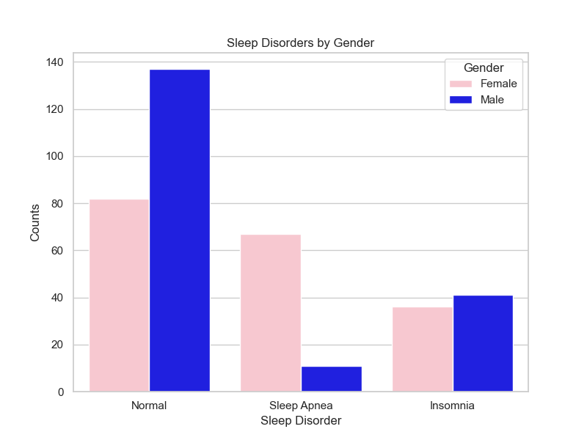
Sleep Disorders and Gender
Most people don’t suffer from sleep disorders.
Contrary to real-life, this dataset showed sleep apnea more prevalent in females.
Insomnia slightly more common in males.

Slide 5

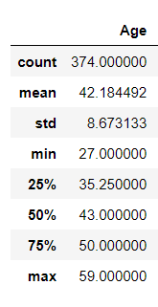
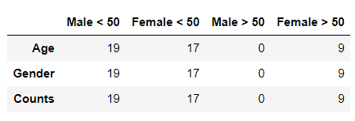
Exploring the dataset
The age of the people in the dataset ranged from 27 - 59 years old, averaging at 42.
No men above 50 years old were included. However, there was several females above the age of 50 in the dataset.

Slide 6
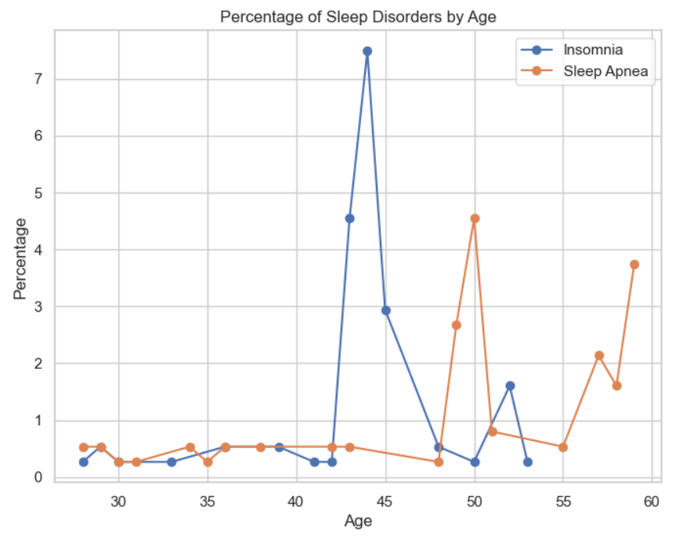
Sleep disorders by Age
- Sleep disorders become more prevalent with age.
- Per dataset, insomnia common in mid 40’s.
- Sleep apnea more common in 50 year olds and above.

Slide 7
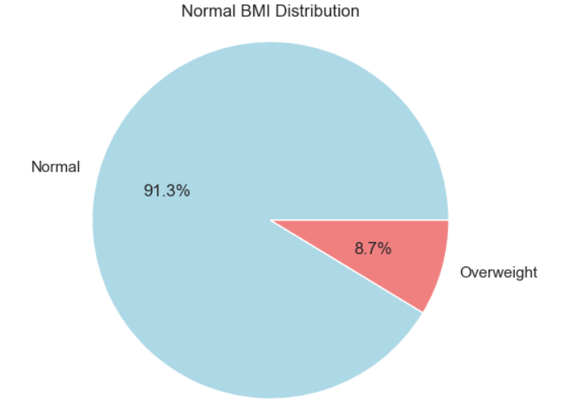
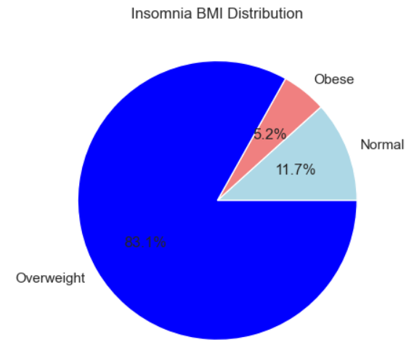
Insomnia vs. BMI
91% of people who don’t suffer from a sleep disorder have a normal BMI.
83% of insomniac people are overweight.

Slide 8
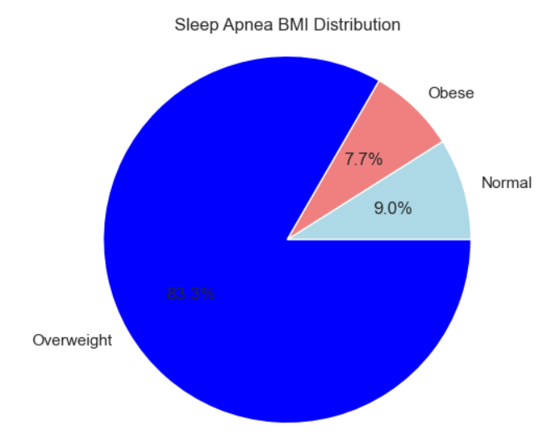
Sleep Apnea vs. BMI
83% of people with sleep apnea are overweight

Slide 9
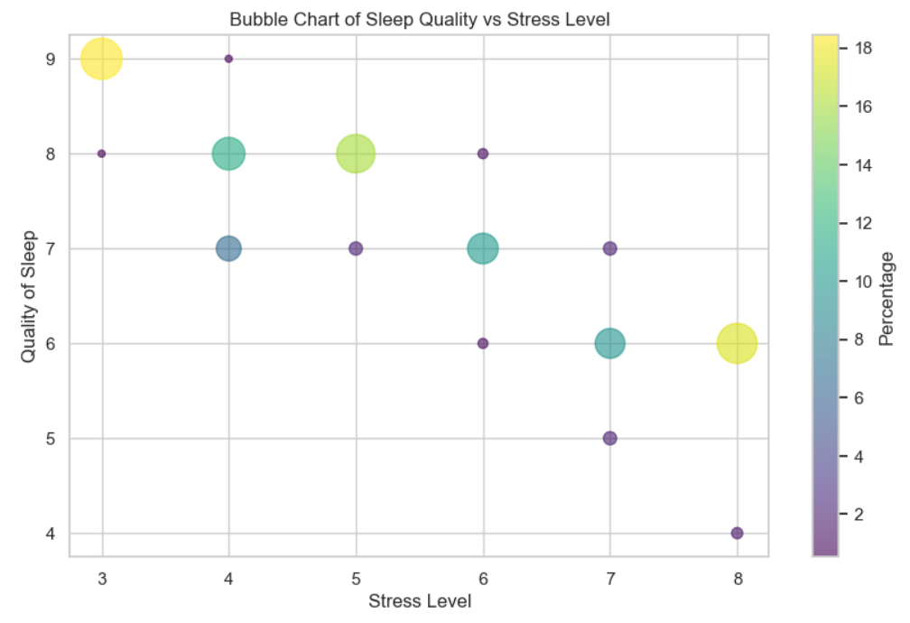
Sleep quality vs. Stress level
As the stress level increases, the quality of sleep decreases

Slide 10
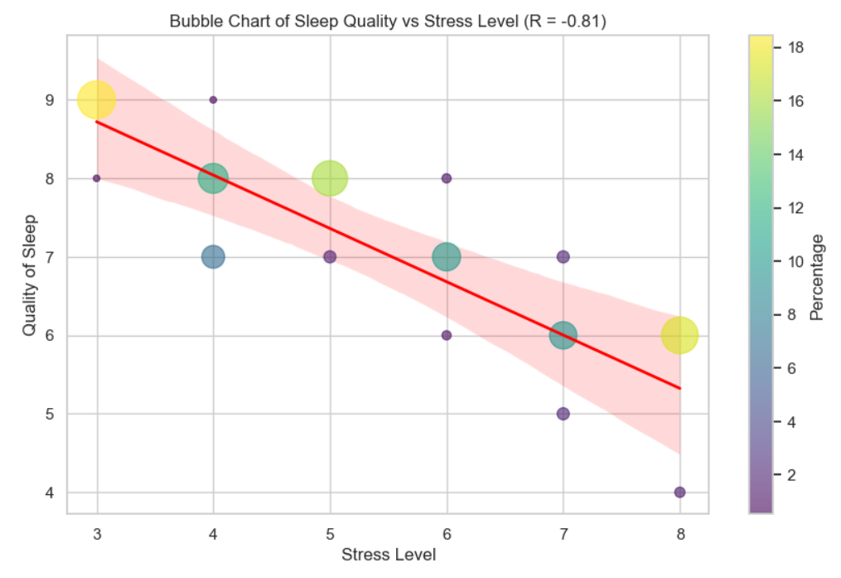
How strong
is the correlation?
With an r-value of -0.81, there is a strong negative linear correlation between the stress level and the quality of sleep

Slide 11
Conclusion
- I partially accept my hypothesis, and partially reject the null hypothesis.
- Sleep disorders are more common in older and overweight people.
- Stress level does negatively affect the quality of sleep.
- No conclusion can be made from this dataset that sleep disorders are more common in females as this data didn’t include males from the same age as the older females.
- More testing is needed to analyze the relationship between sleep disorder and gender.

Slide 12
Reference
Centers for Disease Control and Prevention (CDC). (2022, June 3). Body mass index (BMI). Centers for Disease Control and Prevention. https://www.cdc.gov/healthyweight/assessing/bmi/index.html
Mayo Foundation for Medical Education and Research. (2023, April 6). Sleep apnea. Mayo Clinic. https://www.mayoclinic.org/diseases-conditions/sleep-apnea/symptoms-causes/syc-20377631
Tharmalingam, L. (2023, September 18). Sleep health and lifestyle dataset. Kaggle. https://www.kaggle.com/datasets/uom190346a/sleep-health-and-lifestyle-dataset/data
U.S. Department of Health and Human Services. (2022, March 24). What is insomnia?. National Heart Lung and Blood Institute. https://www.nhlbi.nih.gov/health/insomnia
World Health Organization. (2021, June 9). Obesity and overweight. World Health Organization. https://www.who.int/news-room/fact-sheets/detail/obesity-and-overweight#:~:text=For%20adults%2C%20WHO%20defines%20overweight,than%20or%20equal%20to%2030.

Slide 13
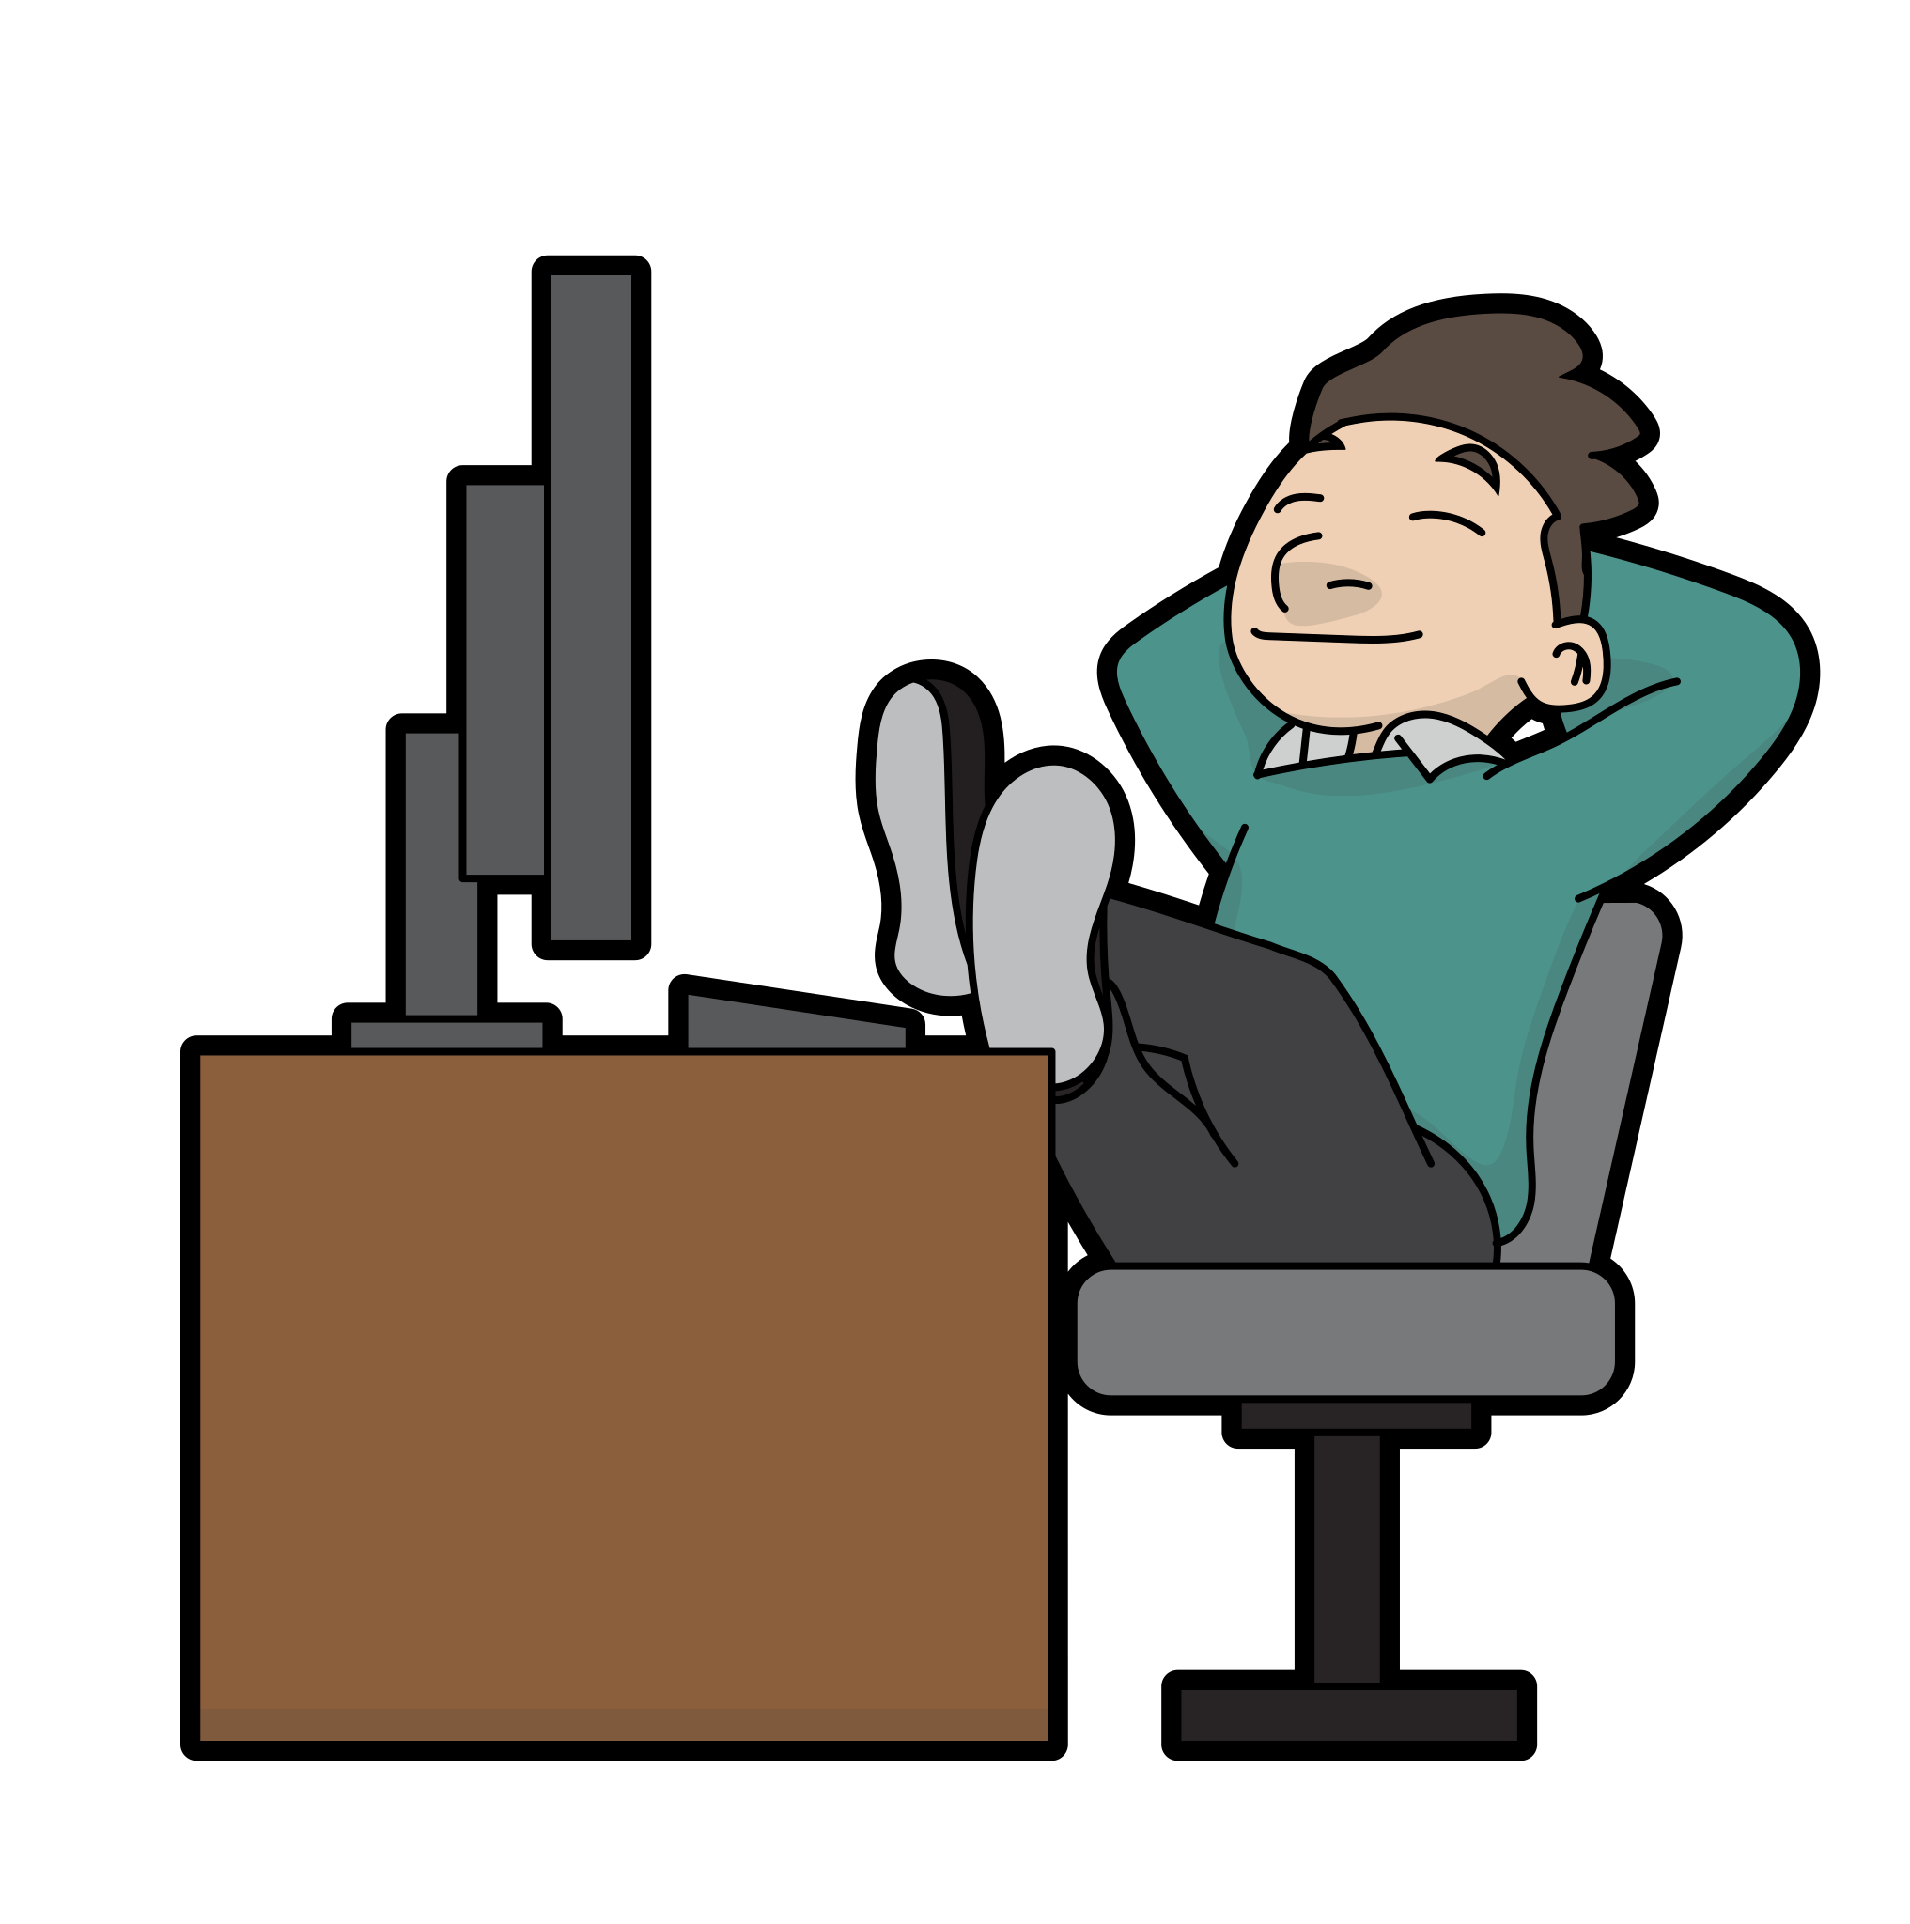
Now it’s time to Sleep!
Thank you for your attention and have a good night
everyone!

